Slide 1

Geometry Unit 1, Lesson 10 Segment Bisectors Volume 1, pg. 63

Slide 2


Benchmarks
MA.912.GR.1.1
Prove relationships and theorems about lines and angles. Solve mathematical and real-world problems involving postulates, relationships, and theorems of lines and angles.
MA.912.GR.5.2
Construct the bisector of a segment or an angle, including the perpendicular bisector of a line segment.
volume 1, pg. 63

Slide 3
Integrated Mathematical Thinking and Reasoning Standards
MA.K12.MTR.1.1 Actively participate in effortful learning both individually and collectively.
MA.K12.MTR.2.1 Demonstrate understanding by representing problems in multiple ways.
MA.K12.MTR.4.1 Engage in discussions that reflect on the mathematical thinking of self and others.
MA.K12.MTR.5.1 Use patterns and structure to help understand and connect mathematical concepts.
volume 1, pg. 63

Slide 4

Learning Targets
I can construct the bisector of a segment.
I use the definition of a midpoint to solve problems.
volume 1, pg. 63

Slide 5

Warm-Up
volume 1, pg. 64

Slide 6
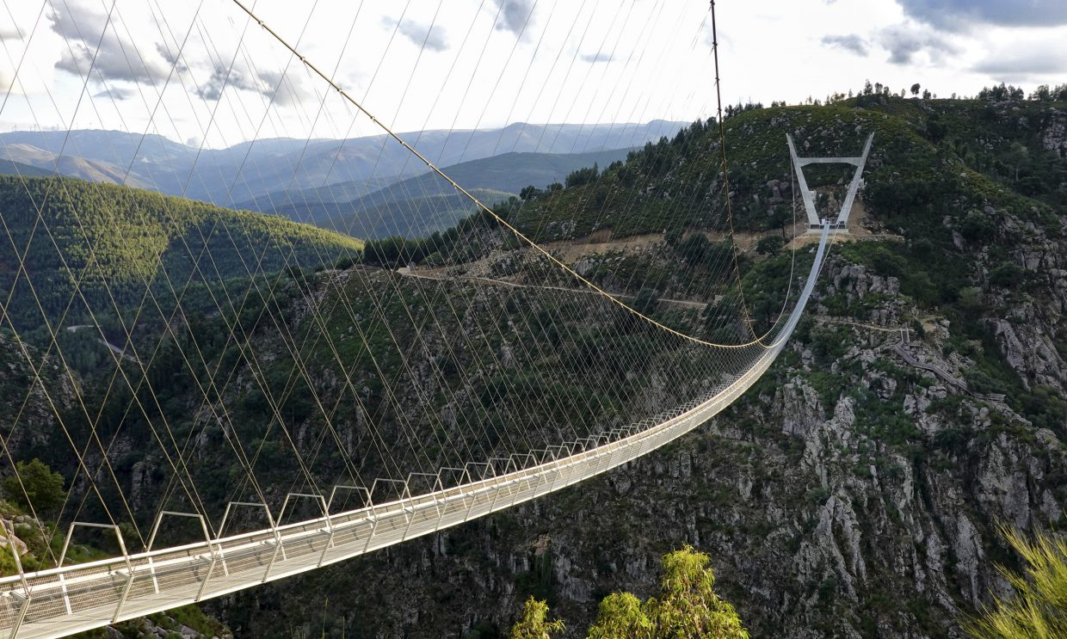
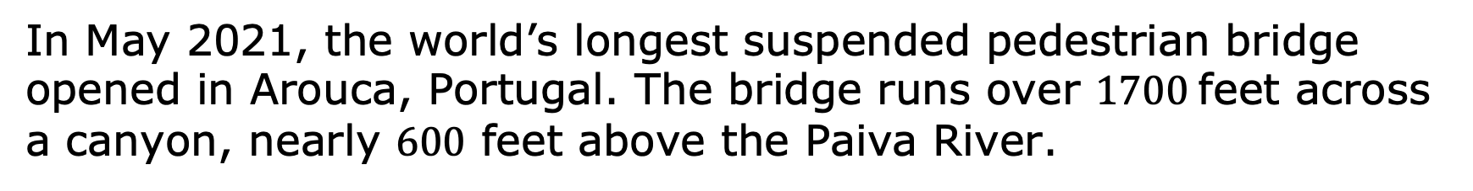
1.10.1 Warm-Up: Notice and Wonder
In May 2021, the world’s longest suspended pedestrian bridge opened in Arouca, Portugal. The bridge runs over $1700$feet across a canyon, nearly $600$ feet above the Paiva River.
volume 1, pg. 64

Slide 7
What do you notice?
What do you wonder?
volume 1, pg. 64

Slide 8

Exploration
volume 1, pg. 64

Slide 9


1.10.2 Exploration: Segment Bisector
Complete the following.
Copy $\overline{TK}$ onto patty paper.
Follow the steps on the copy of $\overline{TK}$.
Fold the copy of $\overline{TK}$ that is on patty paper so the endpoints $T$ and $K$ align.
Place point $M$ on $\overline{TK}$ where the paper folds.
Copy point $M$ onto $\overline{TK}$ above.
Draw a line, a line segment, or a ray through point $M$.
Discuss with your partner what you notice about $\overline{TM}$ and $\overline{MK}$.
volume 1, pg. 64

Slide 10
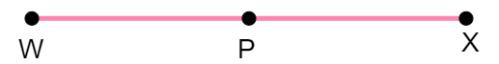
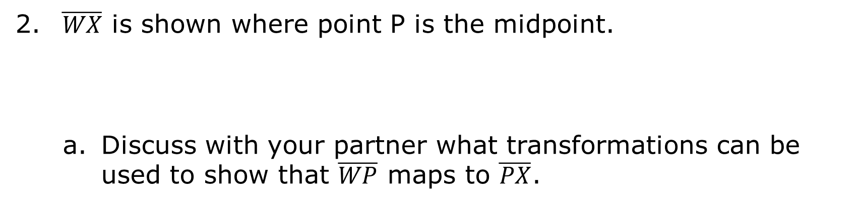
The midpoint of a segment divides it into two congruent segments.
$\overline{WX}$ is shown where point P is the midpoint.
Discuss with your partner what transformations can be used to show that $\overline{WP}$ maps to $\overline{PX}$.
volume 1, pg. 64

Slide 11
Ask two classmates which transformations they selected. Record their transformation and write your summary of their reason. You are the only person who should write in the first two columns of the table. Have the person initial next to your summary stating that your summary was correct.
Transformation | My Summary of Their Reason | Initials
volume 1, pg. 65

Slide 12
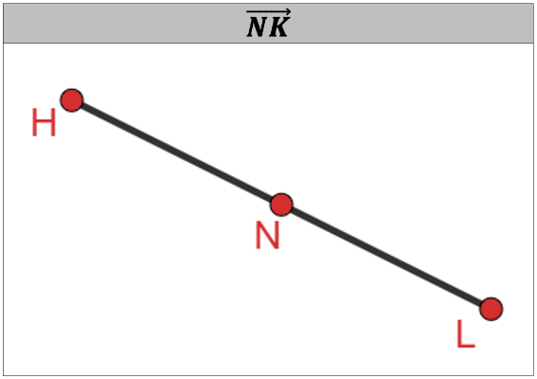
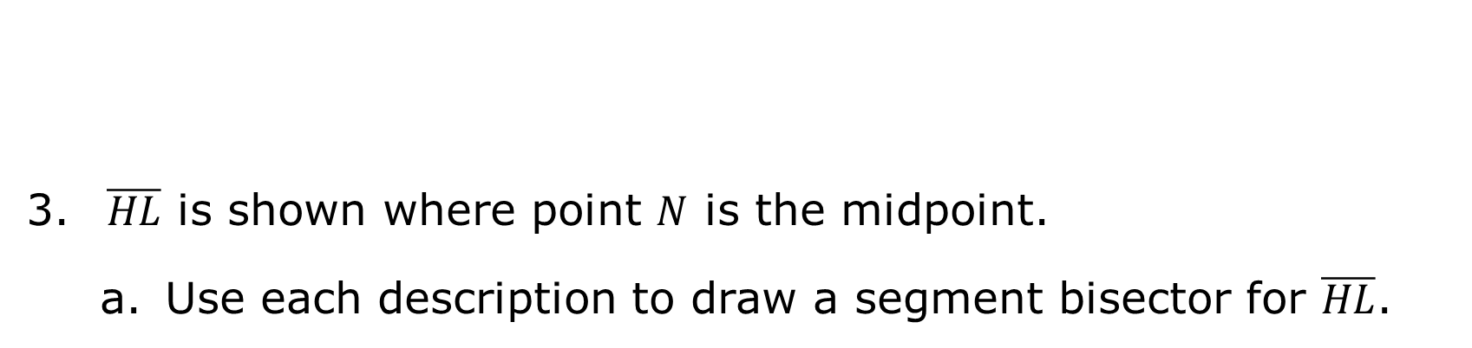
A segment bisector is a line, ray, or line segment that cuts a line segment into two equal parts.
$\overline{HL}$ is shown where point $N$ is the midpoint.
Use each description to draw a segment bisector for $\overline{HL}$.
volume 1, pg. 65

Slide 13
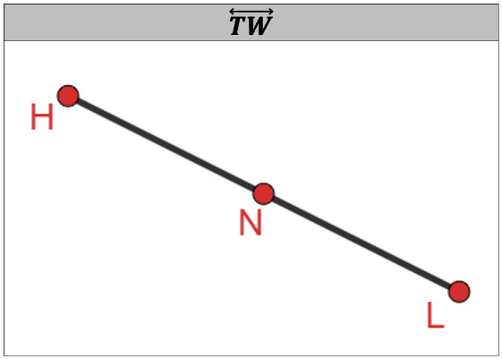
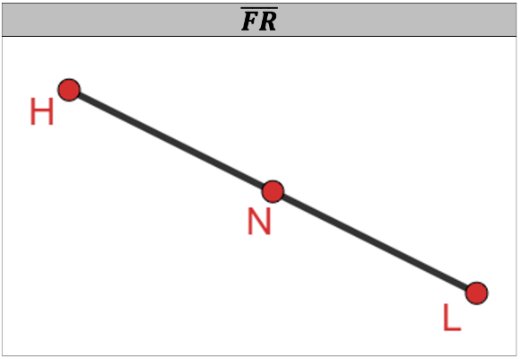

Compare your drawings with your partner.
Using the definition of a segment bisector, discuss with your partner if all of the segment bisectors have to be at the same angle with $\overline{HL}$. Summarize your discussion.
volume 1, pg. 65

Slide 14

$\overline{RD}$ and $\overset{⃡}{HG}$ are shown where point $T$ is the point of intersection.
Use patty paper to copy $\overline{RD}$.
Fold the copy of $\overline{RD}$ to determine if point $T$ is a midpoint.
Complete the sentence.
$\overset{⃡}{HG}$ a segment bisector because point $T$ a midpoint.
is
is not
is
is not
volume 1, pg. 66

Slide 15

Guided Instruction
volume 1, pg. 66

Slide 16

1.10.3 Guided Instruction: Determining Lengths
$\vec{KH}$ bisects $\overline{GB}$ at point $K$.
Draw a diagram of the description.
Determine the value of $x$ if $GK=7x+36$ and $KB=13x−18$.
What is the length of $\overline{GB}$?
volume 1, pg. 66

Slide 17

$\overline{YH}$ and $\overline{MV}$ bisect each other at point $W$.
Draw a diagram of the description.
Determine the value of $b$ if $YH=12b−4.5$, $MV=17b+0.75$, and $MW−WH=13.25$.
volume 1, pg. 67

Slide 18

Guided Practice
volume 1, pg. 67

Slide 19

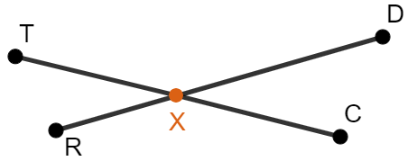

1.10.4 Guided Practice: Determining Lengths
$\overline{RD}$ bisects $\overline{TC}$ at point $X$.
Determine the value of $x$ if $TX=\frac{16}{3}x−41$ and $XC=3x+22$.
What is the length of $\overline{TC}$?
volume 1, pg. 67

Slide 20

Your Turn
volume 1, pg. 68

Slide 21
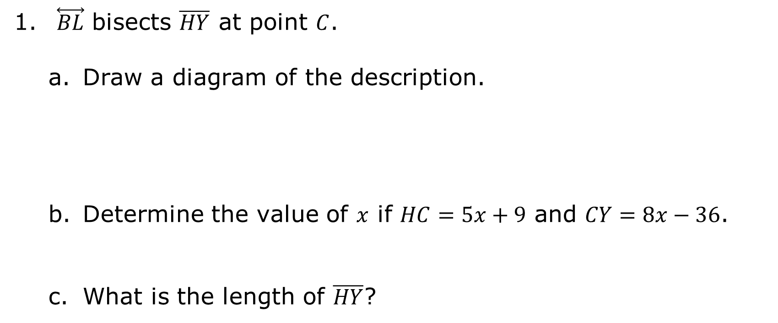
1.10.5 Your Turn!
$\overset{⃡}{BL}$ bisects $\overline{HY}$ at point $C$.
Draw a diagram of the description.
Determine the value of $x$ if $HC=5x+9$ and $CY=8x−36$.
What is the length of $\overline{HY}$?
volume 1, pg. 68

Slide 22

Wrap-Up
volume 1, pg. 68

Slide 23
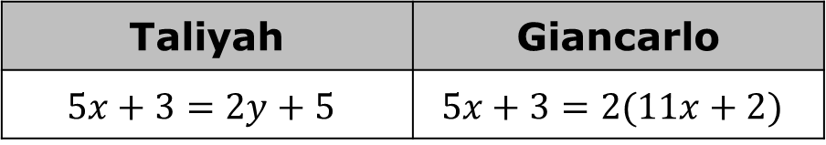
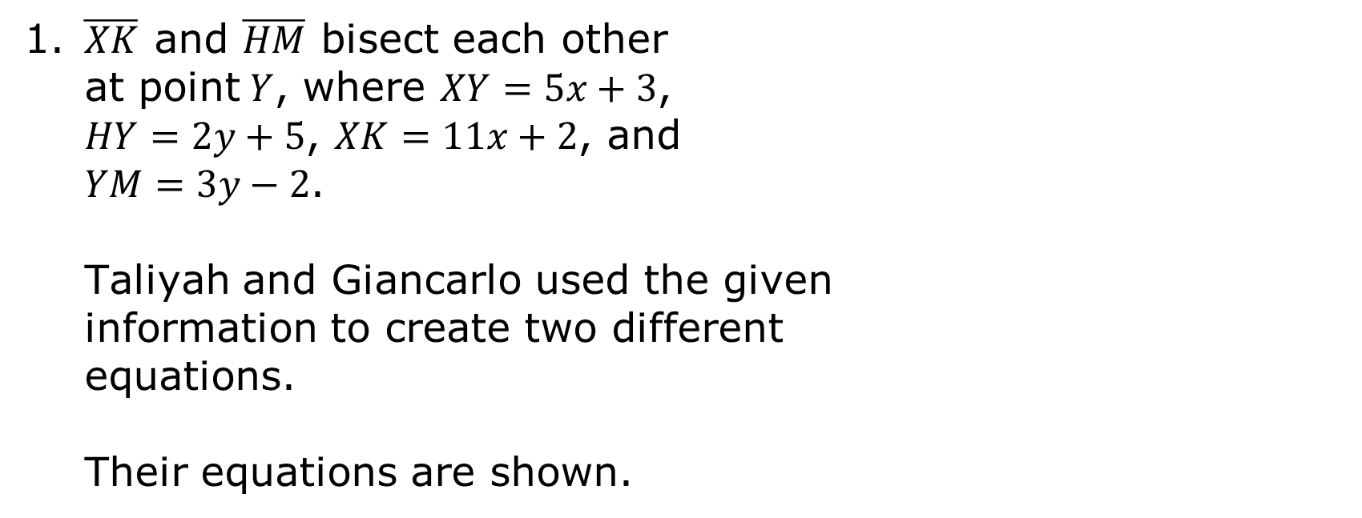
1.10.6 Wrap-Up: Error Analysis
1. $\overline{XK}$ and $\overline{HM}$ bisect each other at point$Y$, where $XY=5x+3$, $HY=2y+5$, $XK=11x+2$, and $YM=3y−2$.
Taliyah and Giancarlo used the given information to create two different equations.
Their equations are shown.
Taliyah | Giancarlo
$$5x+3=2y+5$$ | $$5x+3=2(11x+2)$$
volume 1, pg. 68

Slide 24
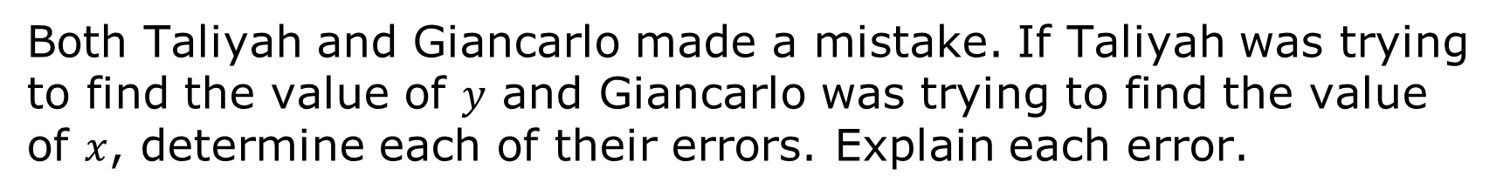
Both Taliyah and Giancarlo made a mistake. If Taliyah was trying to find the value of $y$ and Giancarlo was trying to find the value of $x$, determine each of their errors. Explain each error.
Taliyah | Giancarlo
volume 1, pg. 68

